Slide 1


Slide 2

PRESENTATION​
On​
OBJECT DETECTION AND SOUND RECOGNITION​
FOR BLIND PERSON​
By​
Muhammad Talha(17-NTU-1099)​
Mohsin Iqbal(17-NTU-1088)​
Behzad Ahmed(17-NTU-1079)​
Under the Guidance ​
Of​
Mr. Dr. Asif Habib​ (Supervisor)
Mr. Dr. Muhammad Adeel (Co-supervisor)
National Textile University, Faisalabad​
​
Group ID: 21 - P- 46

Slide 3
TABLE OF CONTENTS
INTRODUCTION
PROBLEM STATEMENT
PROJECT OBJECTIVE
SYSTEM REQUIRMENTS
USE CASE DIAGRAM
CLASS DIAGRAM
TECHNOLOGIES USED
LIMITATIONS
EVALUTION METRICS
RESULTS
DEMO VIDEO

Slide 4
INTRODUCTION
Object Detection and Sound Recognition for Blind Person, as I have named my project name, is a mobile (Android) application which will help the blind person in figuring out the location of an object and guide the person with voice assistance towards it. The application makes use of artificial intelligence and deep learning to detect objects.

Slide 5
Problem Statement
Visually Impaired People confront many problems in moving from one place to another, i.e., navigation. Vision is human’s power to notify him of the obstacles in his way. A solution which is easily available is needed to solve the problems of blind people. The application developed can detect the objects in the user's surroundings. It can alert the user of the obstacles in his pathway and this way helps the user to navigate from one place to another.

Slide 6
Project Objective
Through this app we will help the blind people to find the object in easier way with the help of sound recognition and object detection.
It will assist the blind to find the object which they want.
They need not to ask someone to find things for them.

Slide 7
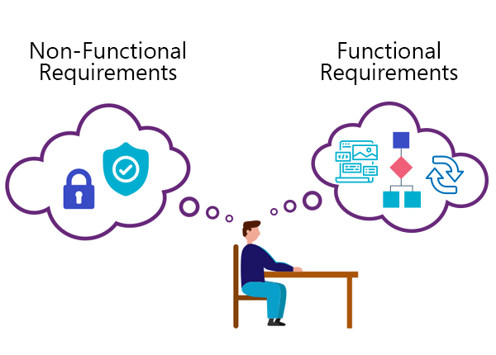
System Requirements
Functional Requirements
Non-Functional Requirements

Slide 8
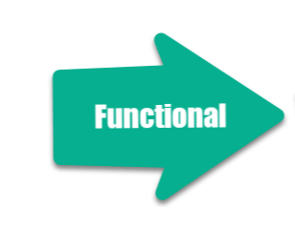
Functional Requirements
User shall open the camera
System shall capture the image.
System shall pre-process the image.
System shall detect the object.
System shall generate the audio
User shall listen the output audio to act accordingly.

Slide 9
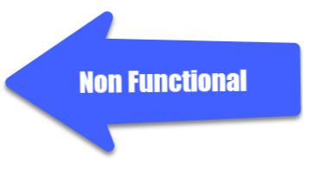
Non-Functional Requirements
Performance
Availability
Reliability

Slide 10
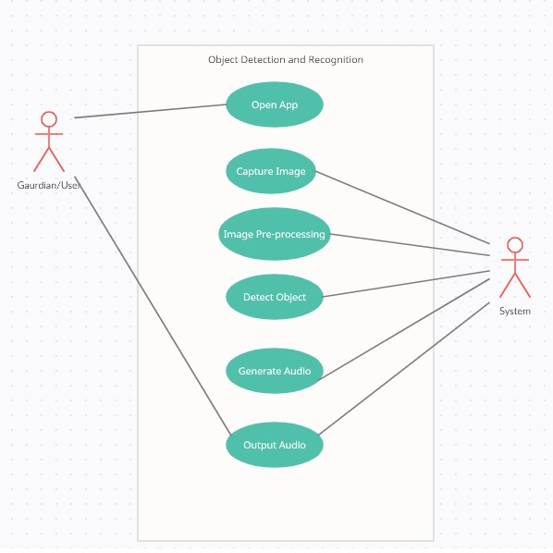
USE CASE DIAGRAM

Slide 11
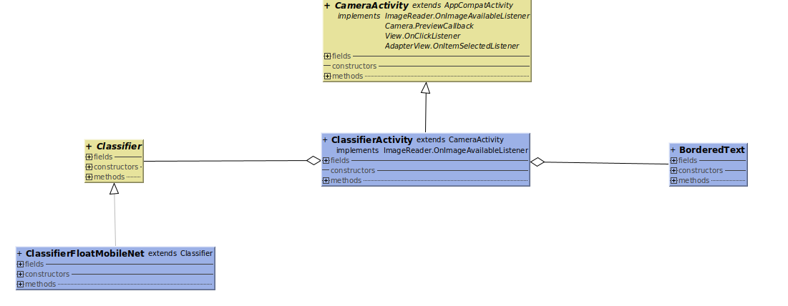
CLASS DIAGRAM

Slide 12
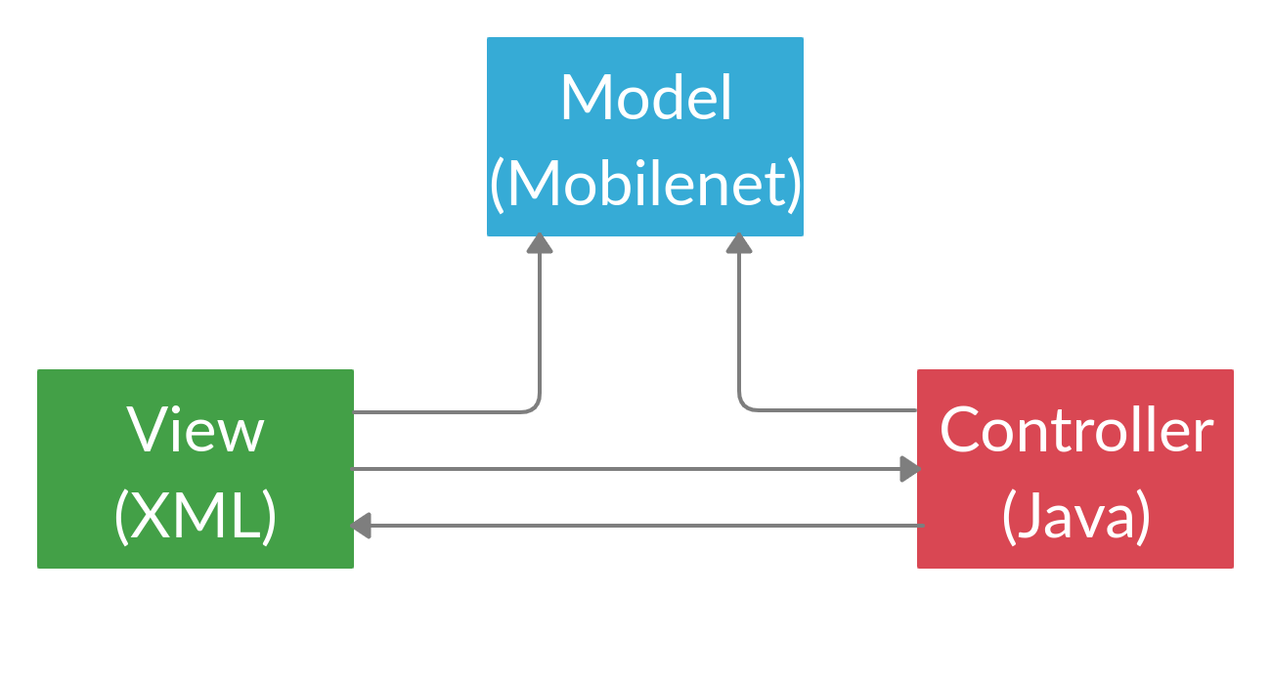
System Design

Slide 13
Technologies Used
Python (used for training the model)
Keras (for building the model)
Colab Notebook (Cloud ML Platform)
Tensorflowlite (Used to convert the model for the mobile use)
Android Studio with Java (Used to implement the android app)

Slide 14
Limitations
Environmental Factors
Strong shadows
Bright lights
Night scenes
Dirt or dust on the camera lens

Slide 15
Evaluation Metrics
True Positive (TP): where the model correctly predicts the positive class.
True Negative (TN): where the model correctly predicts the negative class.
False Positive (FP): where the model incorrectly predicts the positive class.
False Negative (FN): where the model incorrectly predicts the negative class.

Slide 16
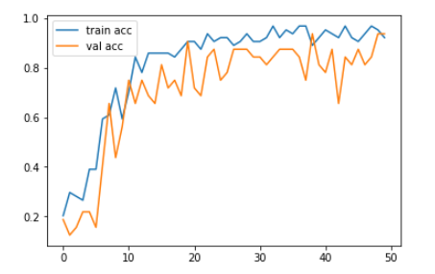
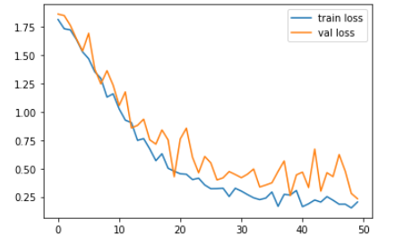
Results

Slide 17
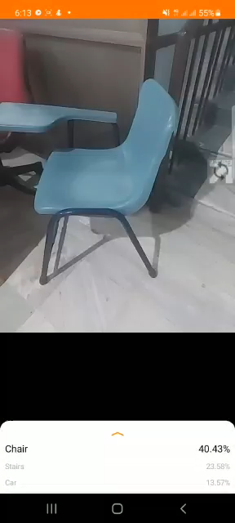
Demo Video

Slide 18


